Slide 1
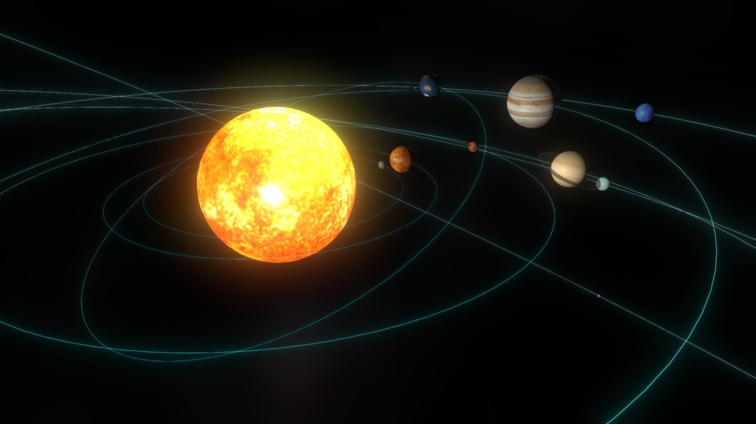
GAME PROGRAMMING COURSE
WEEK 3
Unity Engine Fundamentals & Solar System Simulation
Lectures 5 & 6 | Spring 2026

Slide 2
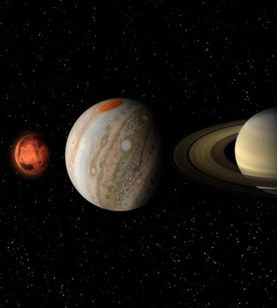
COURSE OVERVIEW
CONTENTS
01
Lecture 5: Game Engine Overview
Game engines, Unity platform, Solar System project introduction, and Unity installation
02
Lecture 6: Unity Development
Project setup, materials, lighting, scripting, prefabs, audio, and finishing the simulation

Slide 3
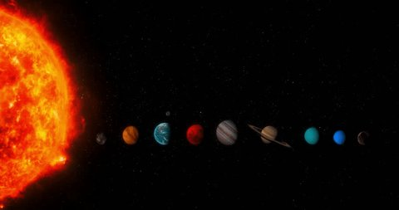
05
LECTURE
GAME ENGINE OVERVIEW
Solar System Project & Unity Installation

Slide 4
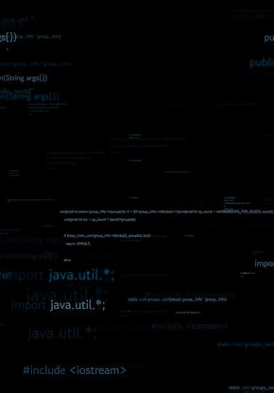
GAME PROGRAMMING — WEEK 3
What is a Game Engine?
A game engine is a software framework that provides the core functionality needed to build video games — rendering, physics, audio, scripting, and more.
Rendering Engine
Physics Engine
2D/3D graphics rendering, shaders, visual effects, and scene composition
Collision detection, gravity simulation, rigid body dynamics
Audio Engine
Scripting Engine
Sound effects, music playback, spatial 3D audio positioning
Game logic, AI behaviors, event handling, custom mechanics
Animation System
Asset Management
Skeletal animation, tweening, state machines, blending
Importing, organizing, and loading textures, models, audio
04

Slide 5
GAME PROGRAMMING — WEEK 3
Popular Game Engines Comparison
Feature | Unity | Unreal Engine | Godot | GameMaker
Language | C# | C++, Blueprints | GDScript, C# | GML
Dimensions | 2D & 3D | 2D & 3D | 2D & 3D | 2D primary
Best For | Cross-platform, mobile, indie | AAA, high-fidelity graphics | Open-source, lightweight | 2D games, beginners
License | Free (Personal) | Free (5% royalty) | MIT (Free) | Free / Paid
Each engine has strengths for different project types, team sizes, and target platforms.
05

Slide 6
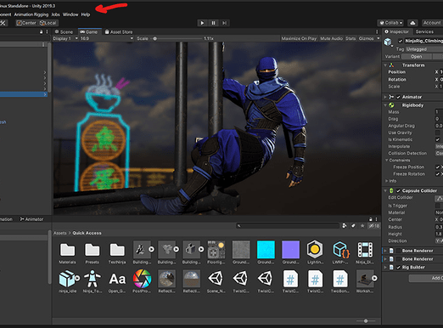
GAME PROGRAMMING — WEEK 3
Unity Engine Overview
Unity is a cross-platform game engine developed by Unity Technologies. First released in 2005, it has become one of the most widely used engines for indie and mobile game development.
Unity uses a component-based architecture where GameObjects with Components are assembled to create game worlds.
KEY FEATURES
Cross-platform (25+ platforms)
Built-in physics (NVIDIA PhysX)
Visual Editor + Real-time preview
Asset Store (thousands of resources)
C# scripting language
Strong 2D and 3D support
Unity Editor interface
06

Slide 7
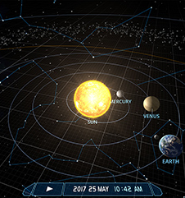
GAME PROGRAMMING — WEEK 3
Solar System Project Overview
The Solar System Simulation is a hands-on learning exercise designed to teach core Unity concepts through building an interactive 3D solar system.
PROJECT OBJECTIVES
Create a realistic 3D solar system with orbiting planets
Implement proper scale relationships between celestial bodies
Apply materials and textures to planet surfaces
Set up lighting to simulate the Sun's illumination
Use C# scripts to control planetary orbits and rotations
Add camera controls for user navigation
Include audio for ambient space atmosphere
07

Slide 8
GAME PROGRAMMING — WEEK 3
Project Goals & Learning Outcomes
By completing this project, students will master the following Unity skills:
1
Understand the Unity Editor interface and workflow
4
Apply materials, textures, and shaders
7
Implement physics-based and scripted animations
2
Learn to import and manage game assets efficiently
5
Configure lighting systems for realistic scenes
8
Use Prefabs for reusable objects across scenes
3
Master GameObject manipulation and hierarchy
6
Write C# scripts for game behaviors and logic
9
Configure audio sources and build a complete app
This project covers the full Unity workflow from initial setup to final build — giving you practical experience with every major engine system.
08

Slide 9
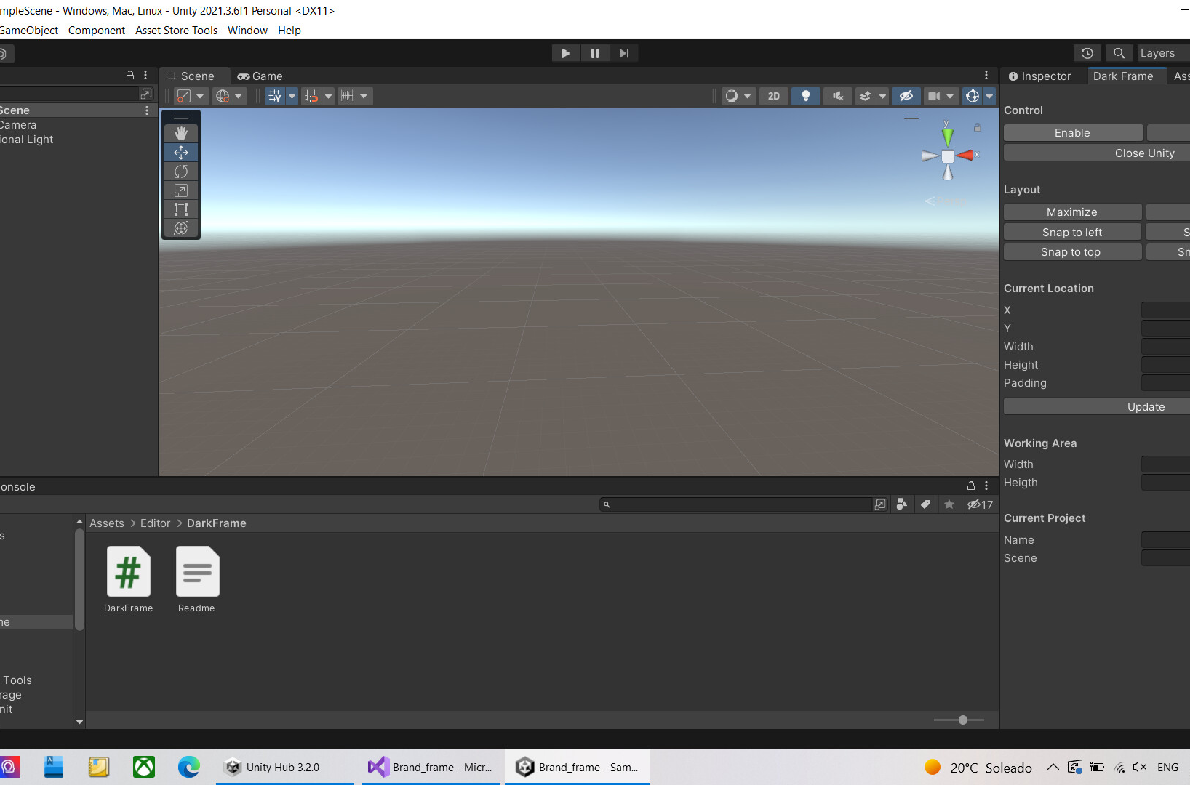
GAME PROGRAMMING — WEEK 3
Downloading Unity Hub
Unity Hub is the central management tool for Unity projects, editor versions, and licenses.
STUDENT TIP
A Personal license is completely free and includes all core features needed for this course. No payment required.
INSTALLATION STEPS
1
Visit unity.com/download and download Unity Hub for your OS
2
Run the installer and follow the setup instructions
3
Create or sign in with a Unity account (free for students)
4
Launch Unity Hub — you're ready to install the Editor
UNITY HUB FEATURES
Project management and organization
Multiple Unity Editor version management
License management (Personal/Plus/Pro)
Direct access to learning resources
09

Slide 10
GAME PROGRAMMING — WEEK 3
Installing the Unity Editor
After installing Unity Hub, follow these steps to install the Unity Editor:
REQUIRED MODULES
Windows/Mac/Linux Build Support
Visual Studio Community (for C#)
Documentation package
Android/iOS support (optional)
1
Open Unity Hub and go to the Installs tab
2
Click "Install Editor" button
3
Choose a Long Term Support (LTS) version for stability (recommended: 2022.3 LTS or newer)
4
Select modules: Windows Build Support, Visual Studio Community, Documentation
NOTE
5
Click Install and wait for the download to complete
LTS versions receive 2 years of support — ideal for long-term projects and education.
10

Slide 11
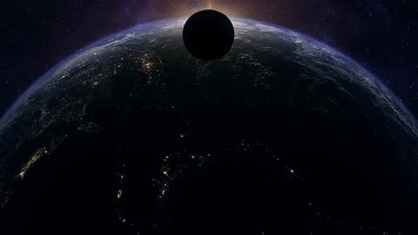
06
LECTURE
UNITY DEVELOPMENT
Project Setup, Core Systems & Solar System Completion

Slide 12
GAME PROGRAMMING — WEEK 3
Unity Editor Interface Setup
The Unity Editor consists of several key windows that work together:
Scene View
Game View
Hierarchy
Visual editing of the game world — navigate, place, and manipulate objects
Preview of the player experience — what the camera sees at runtime
List of all GameObjects in the current scene and their parent-child relationships
Project
Inspector
Console
File browser for all assets — models, textures, scripts, audio, scenes
Properties and components of the selected GameObject — editable in real-time
Logs, errors, warnings, and debug output from scripts and the engine
ESSENTIAL SHORTCUTS
Shortcut | Function | Shortcut | Function
Q | Hand tool (pan view) | Ctrl + S | Save scene
W | Move tool | Space + Click | Maximize window
E / R | Rotate / Scale | Ctrl + Z | Undo
12

Slide 13
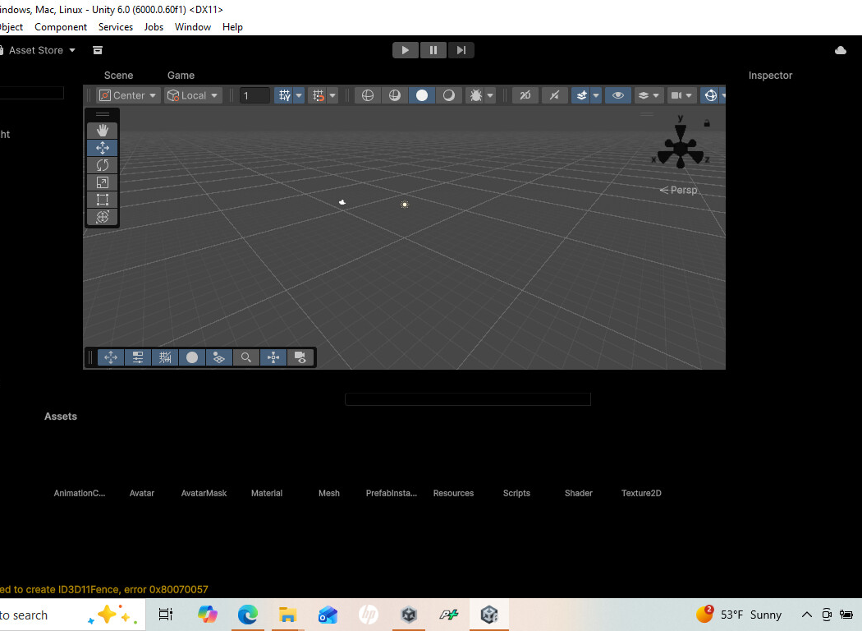
GAME PROGRAMMING — WEEK 3
Creating a New Unity Project
1
Open Unity Hub, go to Projects tab, click "New Project"
URP vs Built-in
2
Select "3D" template (URP recommended)
Universal Render Pipeline (URP) offers better performance and visual quality for most projects.
3
Name the project "SolarSystem"
4
Choose a location and click "Create Project"
DEFAULT PROJECT STRUCTURE
SolarSystem/
Assets/ ← All game resources
Packages/ ← Managed dependencies
ProjectSettings/ ← Configuration files
UserSettings/ ← Personal preferences
Initial scene: Main Camera + Directional Light
13

Slide 14
GAME PROGRAMMING — WEEK 3
Project Structure & Organization
Good folder organization is essential for maintaining a clean, scalable project.
RECOMMENDED FOLDERS
NAMING CONVENTIONS
Assets/
Materials/ ← Shaders, surface materials
Meshes/ ← 3D models
Textures/ ← Image files
Scripts/ ← C# code files
Prefabs/ ← Reusable templates
Scenes/ ← Level/scene files
Audio/ ← Sound effects, music
Resources/ ← Dynamically loaded assets
Use PascalCase for folders and files
No spaces in file names (use underscores)
Use descriptive names — not "Script1.cs"
Organize early — messy projects become unmanageable
WARNING
Renaming or moving files outside Unity breaks references. Always use the Project window.
14

Slide 15
GAME PROGRAMMING — WEEK 3
Downloading & Importing Assets
Assets needed for the Solar System project and where to find them:
ASSETS FOR THIS PROJECT
Textures
Planet surface maps (8 planets)
Skybox/star field cubemap
Audio
Ambient space atmosphere
Materials
Planet surface materials
Sun emissive material
Scripts
Planet rotation, Orbit mechanics
Camera navigation
ASSET SOURCES
Unity Asset Store
NASA 3D Resources
Free space asset packs and tools
Public domain planet textures
OpenGameArt.org
Kenney.nl
Open-source game assets
Free high-quality game assets
HOW TO IMPORT
Download asset files to your computer
Drag and drop into the Project window
Or use Assets > Import New Asset
For Asset Store: Window > Package Manager > My Assets
15

Slide 16
GAME PROGRAMMING — WEEK 3
Working with Materials
Materials define how surfaces appear. They use Shaders to render textures, colors, and surface properties.
MATERIAL WORKFLOW
1. Create Material
Right-click → Create → Material
Name it (e.g., "EarthMat")
2. Assign Texture
Drag texture to Albedo slot
Or click the circle to select
3. Adjust Properties
Metallic: 0 (rocky) to 1 (metal)
Smoothness: surface polish
Emission: for glowing objects
4. Apply to Object
Drag material onto GameObject
Or set via Mesh Renderer
STANDARD SHADER PROPERTIES
Albedo
Metallic
Smoothness
Base color/texture
Metal-like reflection
Surface polish level
Normal Map
Emission
Surface bump detail
Glow effect (for Sun)
CREATING A PLANET MATERIAL
Right-click in Project window → Create > Material
Assign a planet texture to the Albedo slot
Adjust Metallic and Smoothness values
Apply the material to a sphere GameObject
For the Sun: use high Emission for glow
16

Slide 17
GAME PROGRAMMING — WEEK 3
Lighting Systems in Unity
Unity supports multiple light types for different lighting scenarios:
Directional Light
Point Light
Spot Light
Area Light
Simulates distant light like the Sun. Affects all objects uniformly. Main scene light source.
Omnidirectional light from a position. Useful for glowing objects like the Sun.
Cone-shaped light beam. Good for focused illumination and dramatic effects.
Rectangular light surface. Baked only — not real-time. Soft, realistic shadows.
LIGHTING FOR SOLAR SYSTEM
LIGHTING SETTINGS
Use a single Directional Light to simulate sunlight
Enable shadows for realistic planet shading
Adjust ambient light for space darkness
Use the Sun's Emission for a glowing effect
Access via: Window > Rendering > Lighting
• Ambient Color: Dark blue/black for space
• Skybox Material: Space/starfield cubemap
• Global Illumination: Enable for realism
PERFORMANCE TIP
Minimize real-time lights — each additional light increases rendering cost. Use baked lighting for static objects when possible.
17

Slide 18
GAME PROGRAMMING — WEEK 3
Behaviors & C# Scripting
Scripts control GameObject behavior using C#. All scripts inherit from MonoBehaviour.
SCRIPTING CONCEPTS
MonoBehaviour
Base class for all Unity scripts
GameObject
The entity scripts attach to
Transform
Position, rotation, scale access
Component Pattern
Add scripts via Inspector or
AddComponent<T>() in code
Time.deltaTime
Ensures frame-rate independent
movement and rotation
KEY LIFECYCLE METHODS
Start()
Update()
Called once when the object is initialized
Called every frame — use for visual updates
FixedUpdate()
Physics updates at fixed intervals — use for rigidbody and orbit calculations
EXAMPLE: ROTATION SCRIPT
public class PlanetRotation : MonoBehaviour
{
public float rotationSpeed = 10f;
void Update()
{
transform.Rotate(0, rotationSpeed * Time.deltaTime, 0);
}
}
18

Slide 19
GAME PROGRAMMING — WEEK 3
Camera Systems & Controls
Cameras define the player's viewpoint. Unity includes a Main Camera by default in every new scene.
KEY CAMERA PROPERTIES
Transform
Position, Rotation, Scale
Field of View
Camera lens angle (degrees)
Near/Far Clip Plane
Rendering distance range
Clear Flags
Skybox, Solid Color, Depth
Culling Mask
Which layers to render
Viewport Rect
Screen position and size
Depth
Camera rendering order
CAMERA TYPES
Perspective
Orthographic
3D with depth perception. Objects appear smaller with distance. Default for this project.
2D/flat with no depth. Used for isometric games and UI rendering.
CAMERA SETUP FOR SOLAR SYSTEM
Position camera to view the entire solar system
Adjust Field of View (FOV) for desired framing
Enable camera controls for user navigation
Use multiple cameras for overview and close-up views
CAMERA CONTROLS
Action | Input
Zoom / Rotate / Pan | Mouse Scroll / Right-drag / Middle-drag
19

Slide 20
GAME PROGRAMMING — WEEK 3
Audio in Unity
Audio enhances immersion. Unity's audio system has three core components:
Audio Listener
Audio Source
Receives all sound in the scene. Attached to Main Camera by default.
Plays sound in the scene. Attach to GameObjects that emit audio.
Audio Clip
3D AUDIO SETTINGS
The actual sound file (MP3, WAV, OGG). Assigned to Audio Sources.
Spatial Blend
0 = 2D (UI) / 1 = 3D (world)
Volume Rolloff
Logarithmic, Linear, Custom
Min / Max Distance
Audio audible range
Audio Mixer
Volume control and effects
SETTING UP AUDIO
Import an ambient space audio clip
Create empty GameObject: "AudioManager"
Add Audio Source component
Assign the Audio Clip, enable Play On Awake and Loop
20

Slide 21
GAME PROGRAMMING — WEEK 3
Prefabs & Reusability
Prefabs are reusable GameObject templates — create once, use everywhere.
PREFAB WORKFLOW
1. Design Base Object
Sphere mesh
Planet material
Rotation script
Orbit script
2. Create Prefab
Drag to Project window
Name: "PlanetPrefab"
3. Instantiate
Drag into scene 8 times
Customize each instance
4. Update
Edit prefab → all update
Override per-instance
BENEFITS
Create once, instantiate multiple times
Changes propagate to all instances
Reduce scene file complexity
CREATING A PLANET PREFAB
Configure a planet GameObject (sphere + material + script)
Drag from Hierarchy to Project window to create Prefab
Drag prefab back to scene to create instances
Edit the prefab asset to update all instances
Use Prefab Variants for similar objects with slight differences — like planets with unique scales and orbit speeds.
21

Slide 22
GAME PROGRAMMING — WEEK 3
Build & Test Workflow
PLAY MODE TESTING
Click the Play button to test in the Editor. Changes in Play Mode are not saved — exit Play Mode before editing.
PERFORMANCE MONITORING
Stats Overlay
Game View → Stats button
Shows FPS, draw calls, tris
Profiler
Window → Analysis → Profiler
Deep performance analysis
Frame Debugger
Window → Analysis → Frame Debugger
See each rendering step
Target Metrics
Draw calls: < 100 (mobile)
FPS: 60+ consistentlyMemory: Monitor for leaks
BUILD PROCESS
1
File > Build Settings
2
Add open scenes to the build
3
Select target platform (PC/Mac/Linux)
4
Click Build and choose output folder
TESTING CHECKLIST
All planets visible and textured correctly
Orbits and rotations working smoothly
Camera controls functional
Audio playing, no console errors
Performance smooth — target 60 FPS
22

Slide 23
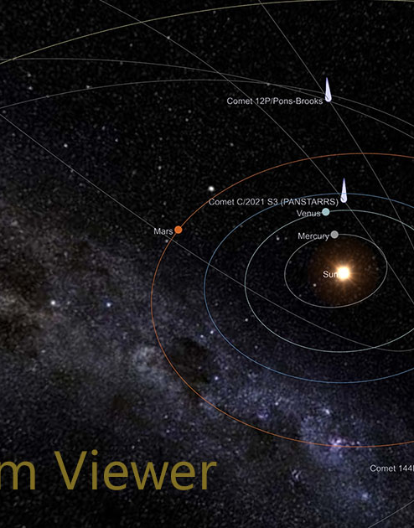
GAME PROGRAMMING — WEEK 3
Finishing the Solar System Simulation
Final assembly — bring everything together to complete the simulation:
The Sun
8 Planets
Center position, emissive material, point light source
Using Planet prefab with unique parameters per planet
PLANET CONFIGURATIONS
Planet | Scale | Orbit Speed | Special
Mercury | Small | Fast | —
Venus | Medium | Slow | Retrograde rotation
Earth | Medium | Medium | With Moon
Mars | Small | Medium | Reddish texture
Jupiter | Largest | Slow | Striped texture
Saturn | Large | Slow | Ring system
Uranus/Neptune | Medium | Very Slow | Tilted axis / Deep blue
23

Slide 24
GAME PROGRAMMING — WEEK 3
Setting Up the Project — Best Practices
Version Control
Performance
Documentation
Set up Git repository
Add .gitignore for Unity
Commit regularly
Use meaningful messages
Use the Profiler
Optimize draw calls
Batch where possible
Use LOD for complex models
Comment your code
Keep a development log
Document custom systems
Note dependencies
BACKUP STRATEGY
Regular Git commits + Cloud backup of project folder = Never lose work
NAMING CONVENTIONS REMINDER
Rule | Example | Rule | Example
PascalCase files | PlanetController.cs | No spaces | SolarSystemScene.unity
24

Slide 25
GAME PROGRAMMING — WEEK 3
Level Design Fundamentals
While the Solar System is a simulation, core level design principles still apply:
Composition
Scale & Proportion
Color Theory
Player Experience
Arrange elements to guide the viewer's attention. The Sun is the focal point.
Balance realism with readability. Exaggerate planet sizes for visibility.
Use color to differentiate planets. Maintain visual harmony across the scene.
Intuitive camera controls. Points of interest: rings, moons, asteroid belt.
ITERATION PROCESS
1. Build Create initial layout
2. Test Get feedback from others
3. Refine Adjust based on feedback
4. Repeat Iterate again
DESIGN TIPS FOR SOLAR SYSTEM
Place the Sun at the center as the primary focal point with strong emissive glow
Create visual paths with orbit trails to guide the eye through the solar system
Add points of interest — Saturn's rings, Earth's moon, Jupiter's great red spot
25

Slide 26
GAME PROGRAMMING — WEEK 3
Game Systems Architecture
A well-structured game uses interconnected systems. For the Solar System project:
Input System
Rendering System
Animation System
Mouse/keyboard for camera control and UI interaction
Materials, lighting, post-processing, skybox rendering
Script-driven planet rotations and orbital mechanics
Audio System
UI System
Data System
Ambient sound management and potential UI audio feedback
Planet information displays and on-screen controls
ScriptableObjects for clean planet data management
SYSTEM COMMUNICATION PATTERNS
Direct References
Events / Actions
Singleton Pattern
Simple component-to-component links for tightly coupled features
Decoupled system communication — subscribe and respond
Use sparingly for global managers (GameManager, AudioManager)
ScriptableObjects are ideal for storing planet data (size, distance, speed) — they keep data separate from logic and are easily editable in the Inspector.
26

Slide 27
WEEK 3 COMPLETE
KEY TAKEAWAYS
You now understand game engines and Unity's role in game development
How to set up Unity, create projects, and organize assets
Core Unity systems: Materials, Lighting, Scripts, Cameras, Audio, Prefabs
The complete workflow from project creation to build
How to build a complete Solar System simulation from scratch
NEXT WEEK
Advanced scripting, physics interactions, and player mechanics
Keep experimenting — add moons, asteroid belts, or interactive planet info panels!

